Slide 1









Guo, Yu (郭煜)
Education:
Ph.D
M.S
B.A
Working experiences:
Current
Intern
Intern
Intern
Intern
RA

Slide 2
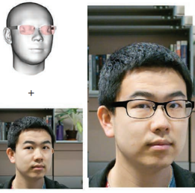
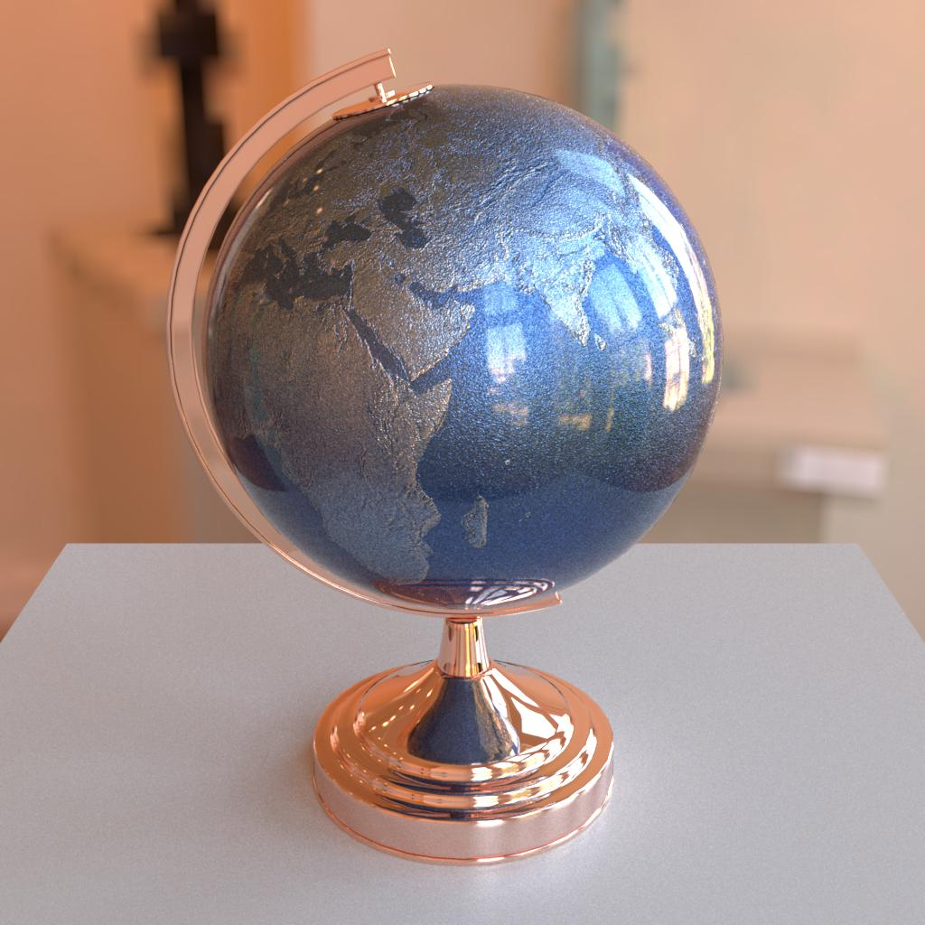
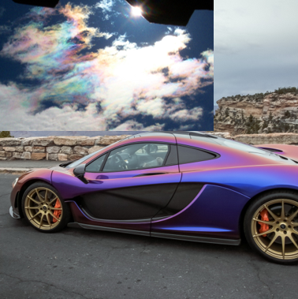


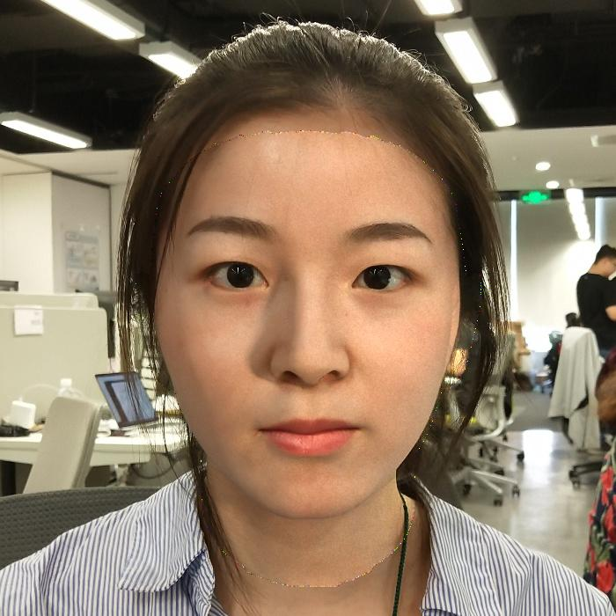
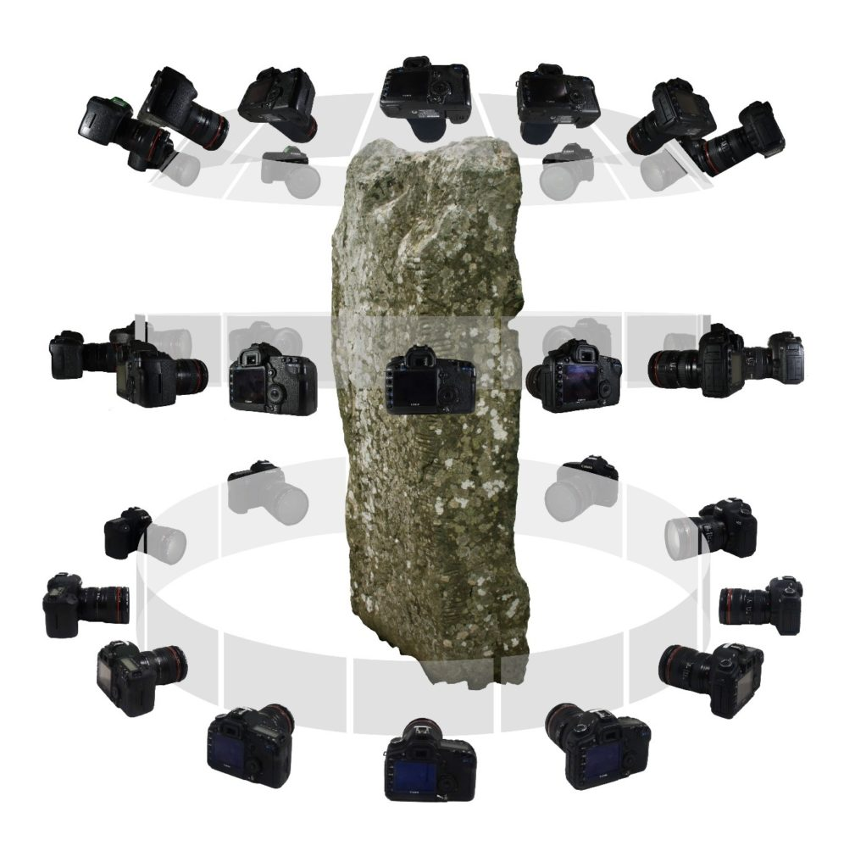
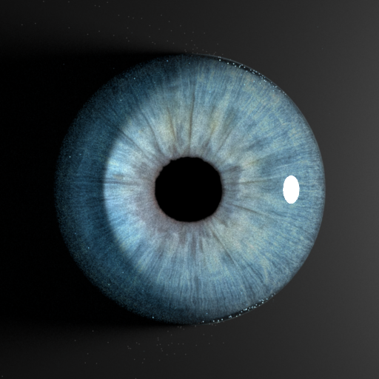
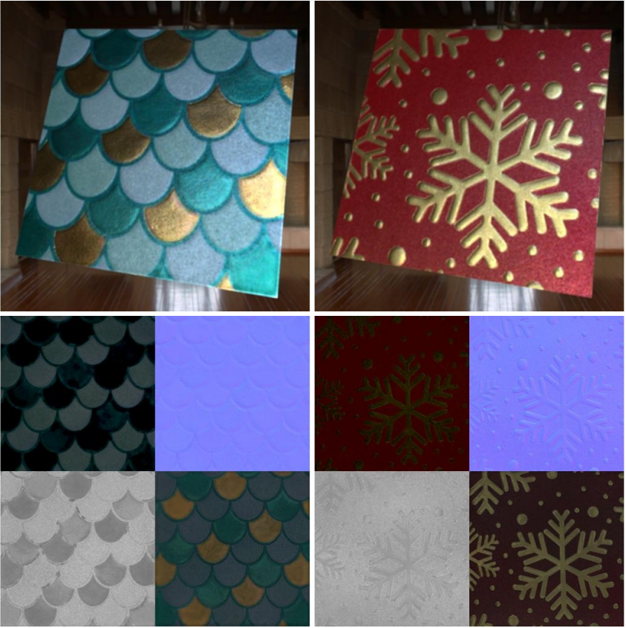
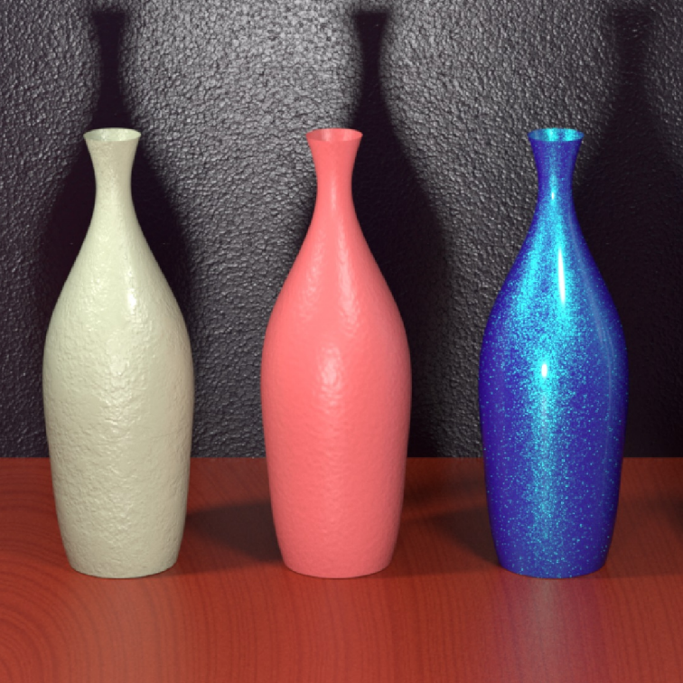
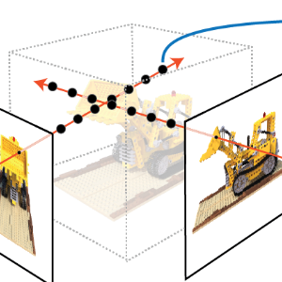
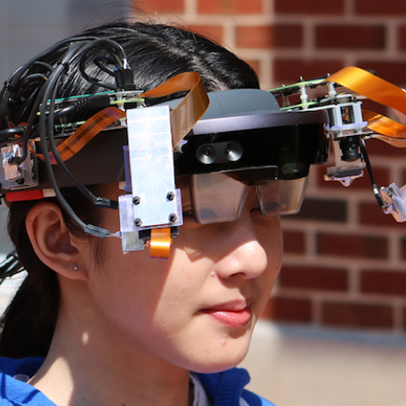
Projects
Face related:
Material modeling
Tencent Games
Unreal Engine plugin development
Virtual try-on
[Source from: website]
Layered BRDF
Particle scattering
Photogrammetry workflow optimization
Face relighting
Material capture
Eye caustic
A new workflow of 3D asset creation
SVBRDF
Procedural model
[Source from: Xinran Lu]
Face reconstruction

Slide 3
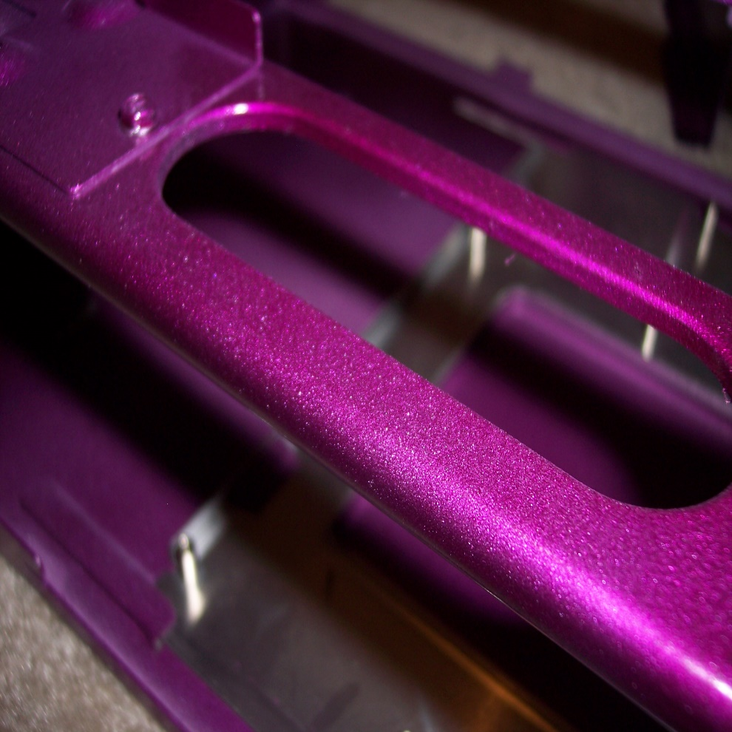
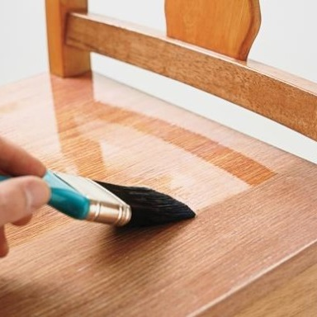
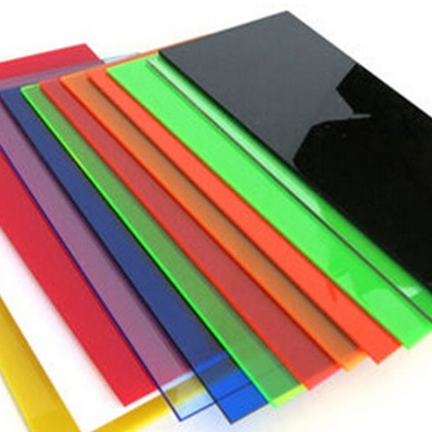

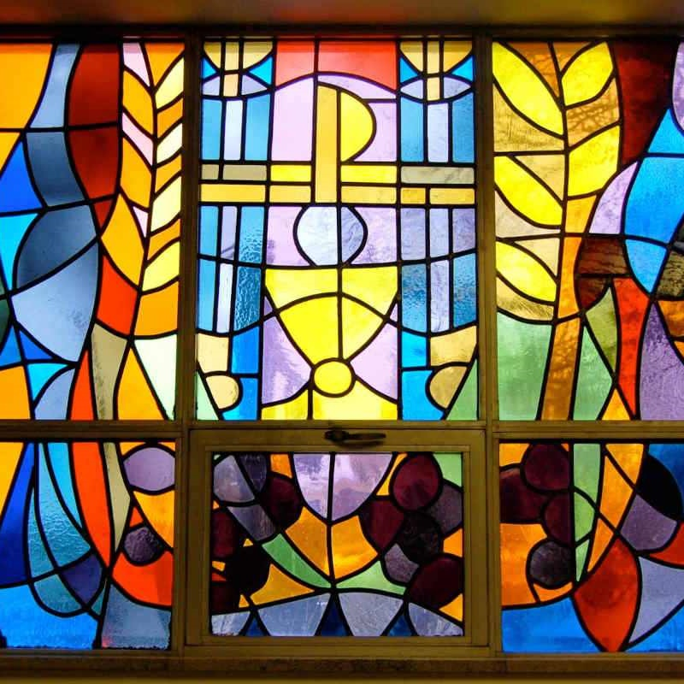
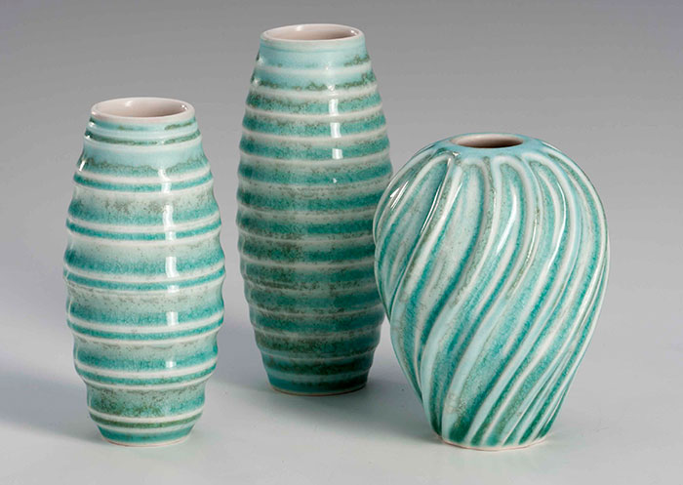
Layered Materials
Metal
Wood
Plastic
Ceramics
Glass
Ours
BSSRDF ≈ BSDF
Silicide
Paint
Ceramic
Notes:
If we take a close look at the surface of a layered material,
[C] we can see a stack of layers with reflective or refractive interfaces and sometimes participating media in between.
[C] When light hits a layered material,
[C] it can reflect and refract off the layer interfaces and scatter within the layers in complex ways.
[C] Fortunately, as the layers are generally very thin, one can usually neglect the displacement between the locations at which light enters and leaves the material.
[ceramic coating: https://www.pvd-coatings.co.uk/coatings/ceramic-coatings/]

Slide 4
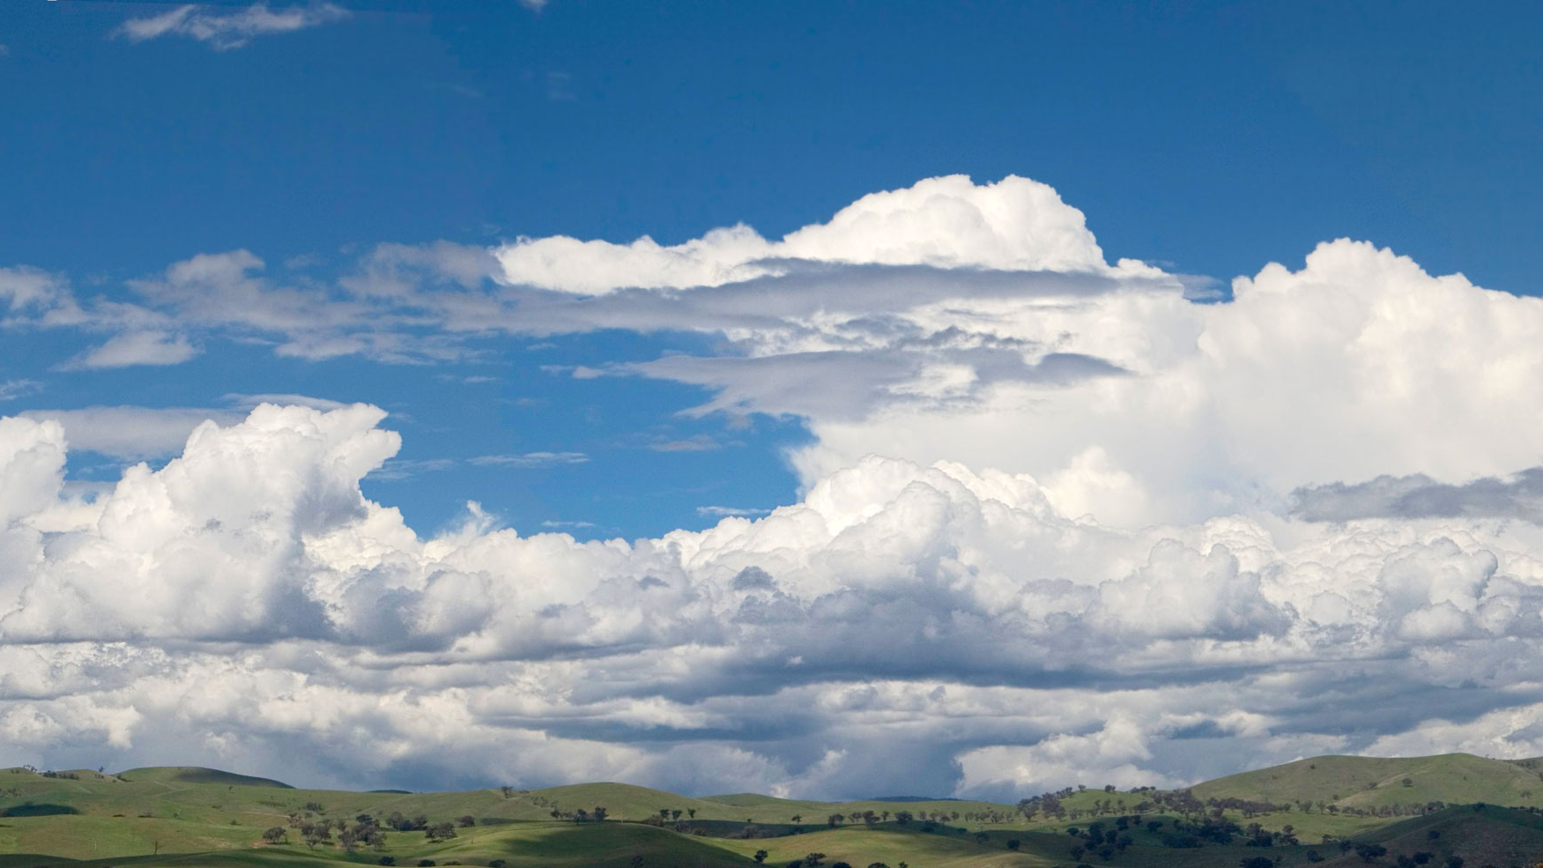


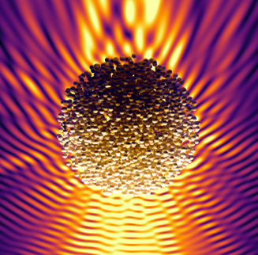


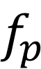
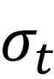
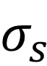
Particle scattering
Limitation
Far-field approximation
$$∞$$
Ours
Near-field scattering in cluster
Far-field approximation between clusters
$$σ_{s}$$
$$∞$$
$$σ_{t}$$
$$f_{p}$$
Hybrid mode
Scattered field
:scatterer
:cluster
Notes:
Now let’s look at the clouds for example,
[C] The light travels through the clouds with scattering and absorption, and then observed by our eyes.

Slide 5



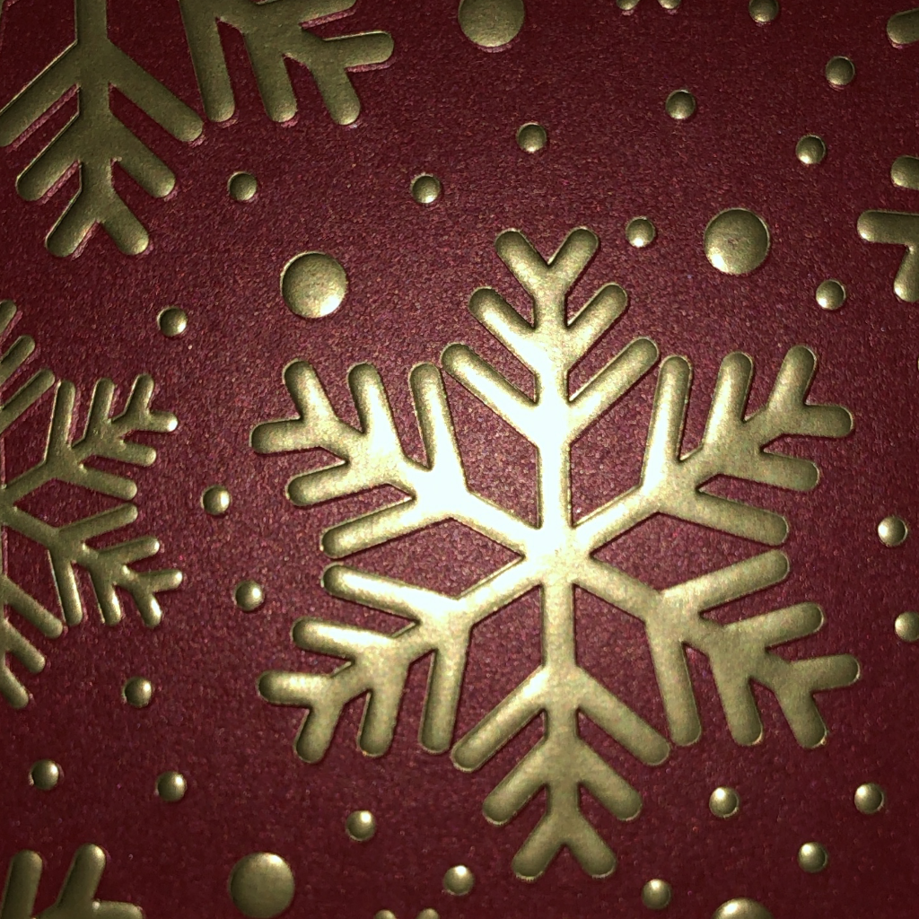
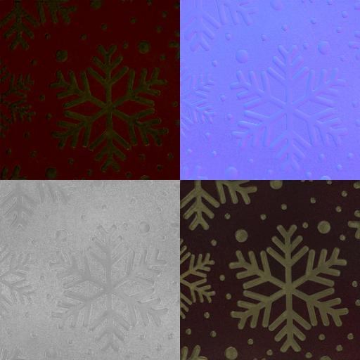
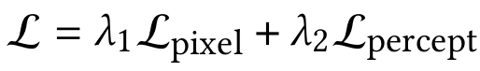
SVBRDF
Ours
W⁺,N
Renderer
Material
GAN
(generator)
Captures
SVBRDF maps
Renders
Diffuse
Albedo
Optimization based on Differentiable Rendering
Normal
Captures
Specular
Albedo
Roughness
Notes:
A widely used material model in industry is Cook-Torrance, it allows to represent well many opaque surfaces with just 4 parameter maps representing the surface orientation, the diffuse and specular light reflection and shinyness or roughness. Together these parameters form what we call a SVBRDF.

Slide 6
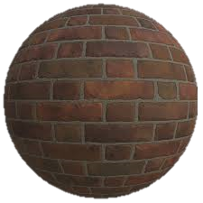
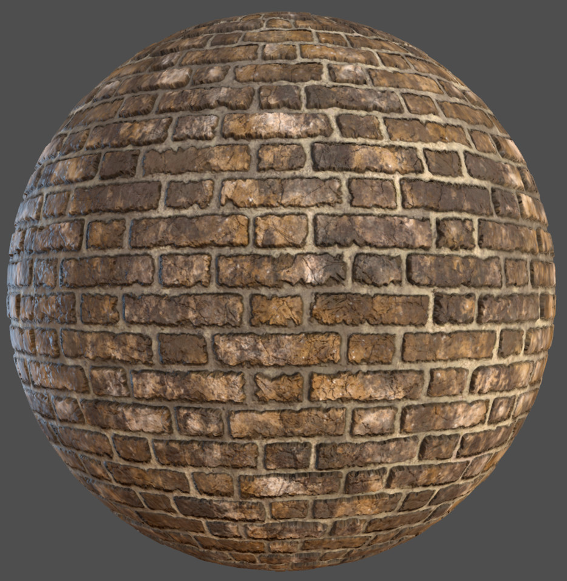
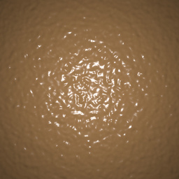
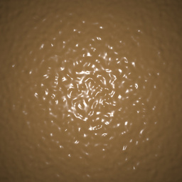
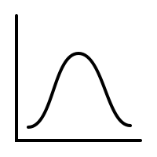
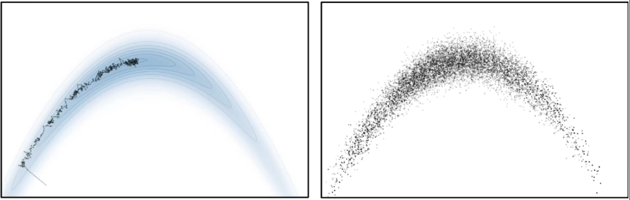
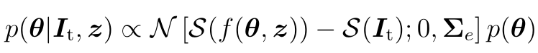
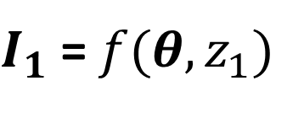
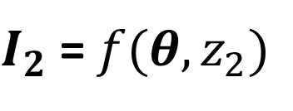
Procedural materials
θ
Procedural generation
Rendering
Rendered
Target
Inverse problem
$I_{1}$ = $f(θ, z_{1})$
$I_{2}$ = $f(θ, z_{2})$
Ours
Optimization
Gradient descent Optimization
HCMC Sampling
Sampling
Posterior
Likelihood
Prior
Notes:
For a captured image, [C] to estimate the procedural model parameters, [C] we need to solve the inverse problem.
[C] However, the procedural generation and physics-based rendering is a complex process with a diverse set of operations,
making the relationship between procedural model parameters theta and the final renderings non-linear and non-trivial.
[C] Additionally, how to match the rendered image to the target is not obvious.
Per-pixel alignment is no longer available here.
Finally, instead of a single “best” match, [C] user may prefer a collection of plausible matches that they can choose from.

